Slide 1



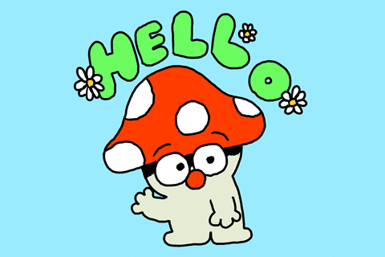

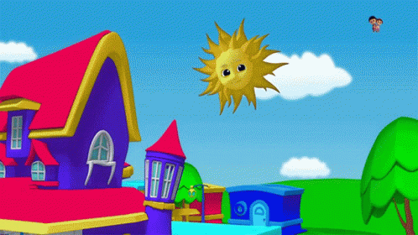

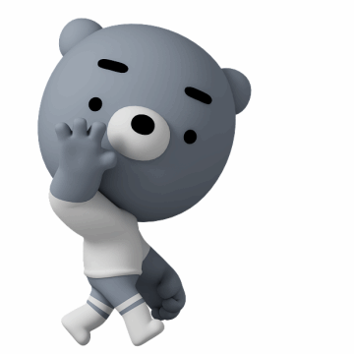



GREETINGS
Good evening
bilgeceingilizce

Slide 2
bilgeceingilizce

Slide 3
bilgeceingilizce

Slide 4
bilgeceingilizce

Slide 5
Good evening
bilgeceingilizce

Slide 6
bilgeceingilizce

Slide 7
bilgeceingilizce

Slide 8


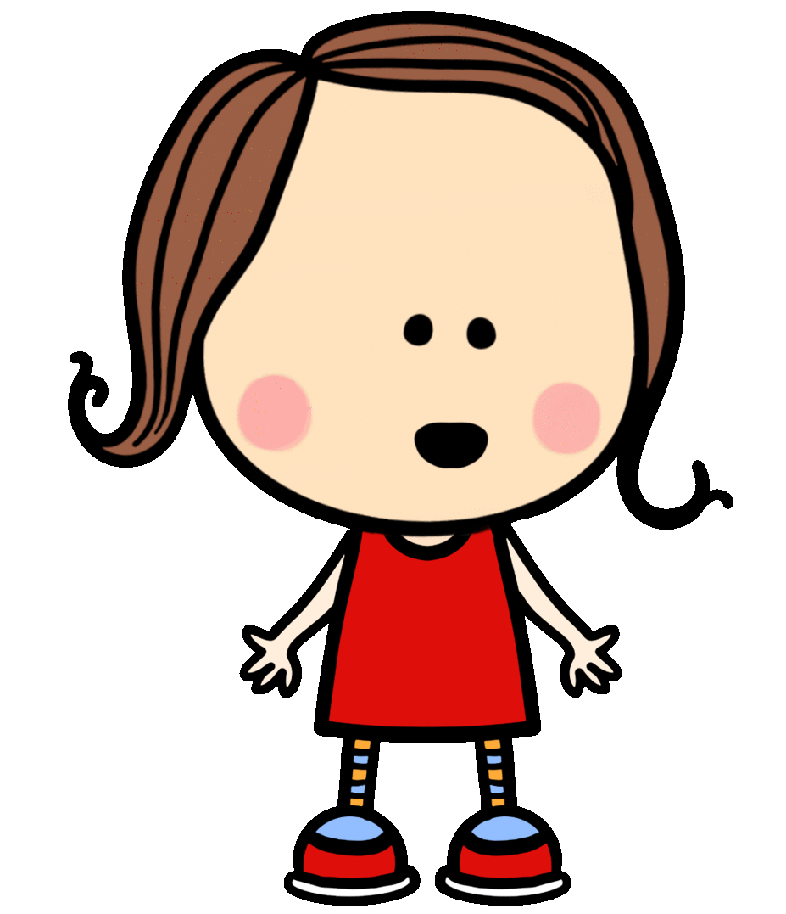
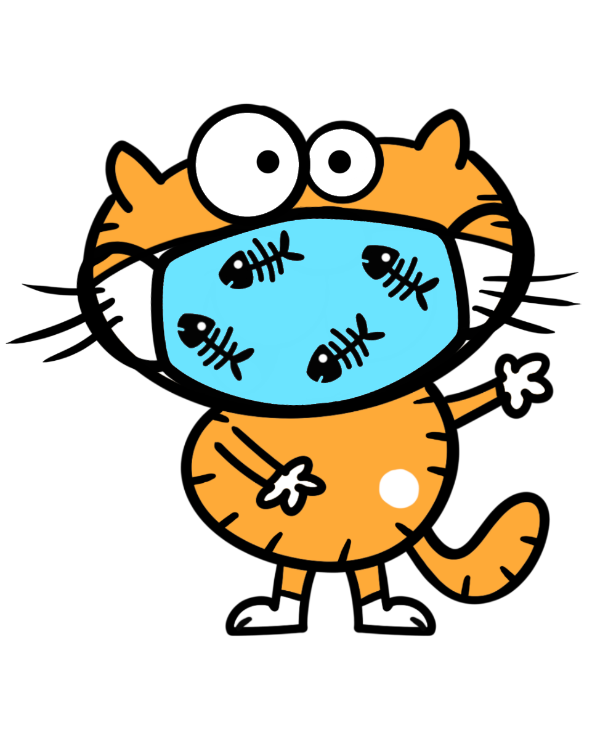

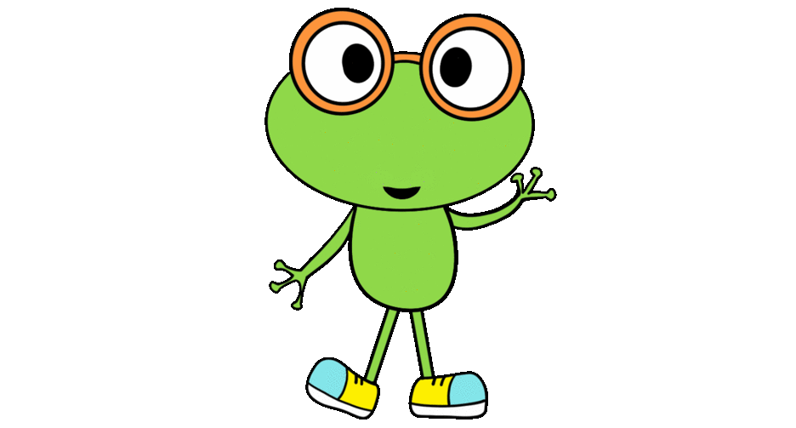
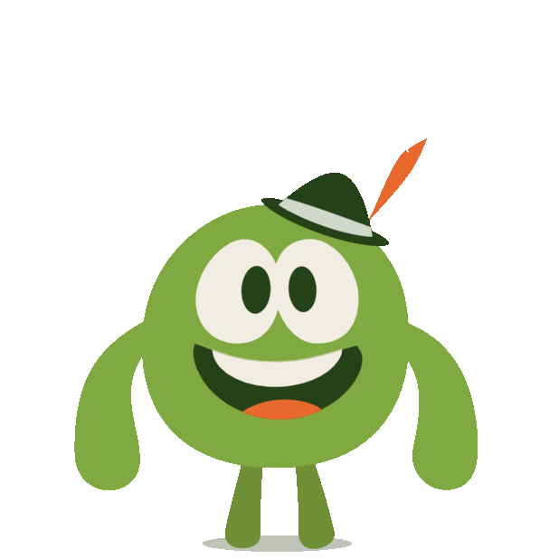
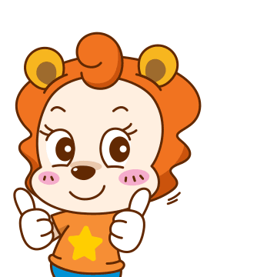

MEETING
What’s your
name?
My name
is Rosy.
What’s your
name?
I’m Froggy.
I’m fine,
thank you.
How are
you?
I’m okay,
thank you.
How are
you?
How are you?
Great,
thanks.
bilgeceingilizce

Slide 9
My name
is Rosy.
What’s your
name?
bilgeceingilizce

Slide 10
What’s your
name?
I’m Froggy.
bilgeceingilizce

Slide 11
I’m fine,
thank you.
How are
you?
bilgeceingilizce

Slide 12
I’m okay,
thank you.
How are
you?
bilgeceingilizce

Slide 13
Great,
thanks.
How are you?
bilgeceingilizce

Slide 14
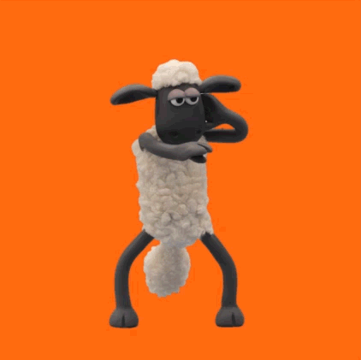
bilgeceingilizce

