Slide 1


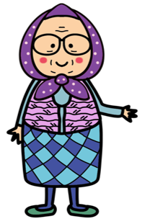


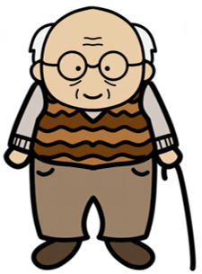

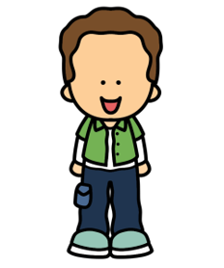





MY FAMILY
Father
Aunt
Uncle
Mother
Grandfather
Grandmother
Lucy
Cousin
Brother
Max
Sister
bilgeceingilizce

